Slide 1

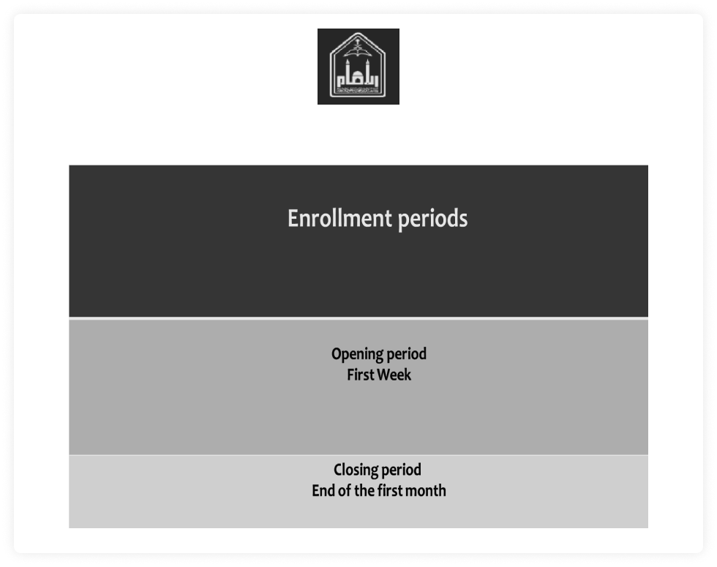
Home
Login
Register
Al Imam Daycare site

Slide 2

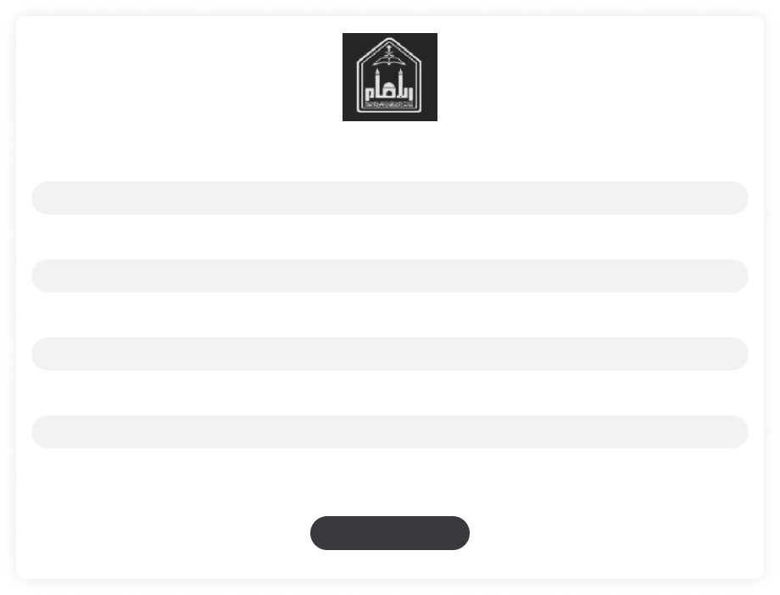
Home
Login
Register
Al Imam Daycare site
Username
Email
Password
Phone
Register

Slide 3

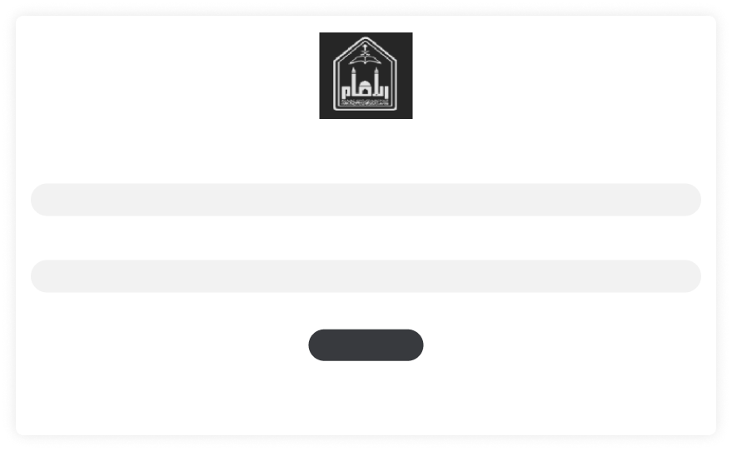
Home
Login
Register
Al Imam Daycare site
Username
Password
Save Password
Login

